Slide 1

Frontend JavaScript
Version Control
www.pragmatic.bg
Lector: Stiliyan Ivanov
Skype: stiliyan.iv.ivanov
E-mail: stiliyan.ivanov [at] pragmatic.bg
Facebook: https://www.facebook.com/stiliyan.iv.ivanov
LinkedIn: https://www.linkedin.com/in/stiliyan-iv-ivanov/
Copyright © Pragmatic LLC 2013 – 2019

Slide 2

Table of Contents
What is version control software?
Why do you need it?
Where did it come from?
Types of VCS
How does it work?
Which one should I use?
How do I start using it?

Slide 3
What is Version Control Software?
Version Control Software (VCS) is a set of:
programs that manage changes to computer files, such as documents, images and source code.
Also known as:
Revision control software
Version management software
Source control software
Configuration management software

Slide 4
Why Do You Need It?
Undo, incremental backup of changes
Trying out ideas
Integrating several sources or subsystems
Collaboration with other people
Troubleshooting
Statistics
Productivity
Sanity

Slide 5
Does This Look Familiar?

Slide 6
Where Did It Come From?
Engineering: blueprints
Law: contract redline, legal backline
Software Development: early UNIX days
SCCS: 1972, Bell Labs, Marc J. Rochkind
diff: 1974, AT&T, Hunt-McIlroy algorithm
RCS: 1982, GNU, Walter F. Tichy
patch: 1985, Larry Wall
CVS: 1986, Dick Grune
Subversion: 2000, CollabNet, Apache
Git: 2005, Linus Torvalds

Slide 7
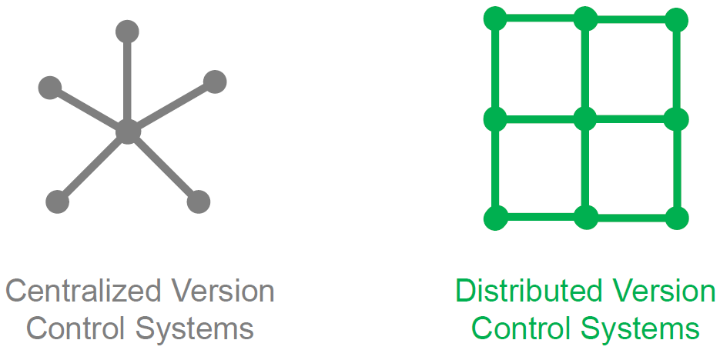
Types of VCS

Slide 8
How Does It Work?

Slide 9
How Does It Work?
Repository
Revisions
Tree baseline
Branches
Tags
Wikipedia: Version control

Slide 10
How Does It Work?

Slide 11
How Does It Work?

Slide 12
Which One Should I Use?
Git
If you can't use Git, use anything else
Make sure you do use something!
Git is free and Open Source
Git is distributed
Git is cross-platform (Linux, Windows, ...)
Git is very fast. And smart.
Git is de fact standard in Open Source world
Git is on the GitHub

Slide 13
How Do I Start Using It?
You are probably already using it via:
Microsoft Office, OpenOffice.org, KOffice, WordPress, Drupal, Joomla, or Wiki engine.
Install Git
Tutorials, book (http://book.git-scm.com)
Try and play
Register GitHub account
Enjoy!

Slide 14
How Do I Start Using It?
Once off
$ git config --global user.name "Stiliyan Ivanov"
$ git config --global user.email "stiliyan@postplanner.com"

Slide 15
How Do I Start Using It?
Once per project
$ mkdir Project
$ cd Project
$ git init

Slide 16
How Do I Start Using It?
Simple workflow
$ vim README
$ mkdir Files
$ mv /tmp/*.pdf Files/
$ git add :/
$ git commit -m "Initialized the project"
$ git rm Files/invoice123.pdf
$ git commit -m "Removed invoice123.pdf from the project"
$ vim README
$ git diff
$ git add :/
$ git commit -m "Added copyright notice to README"
$ git log

Slide 17
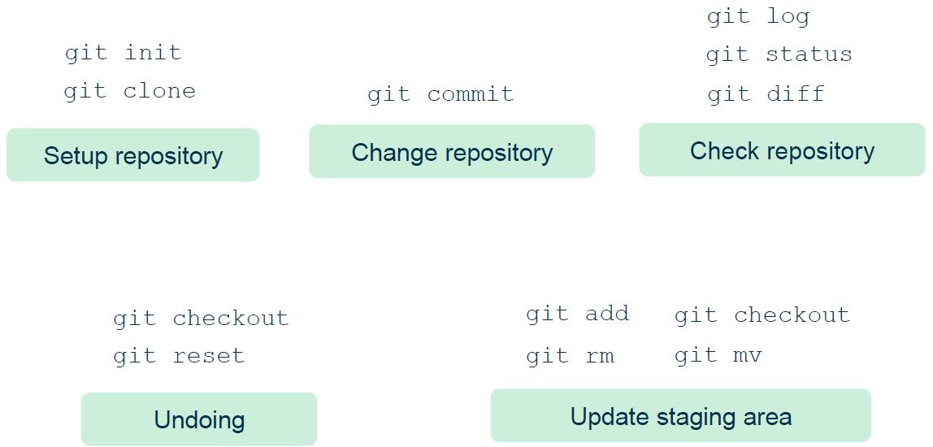
Git in Daily Development

Slide 18
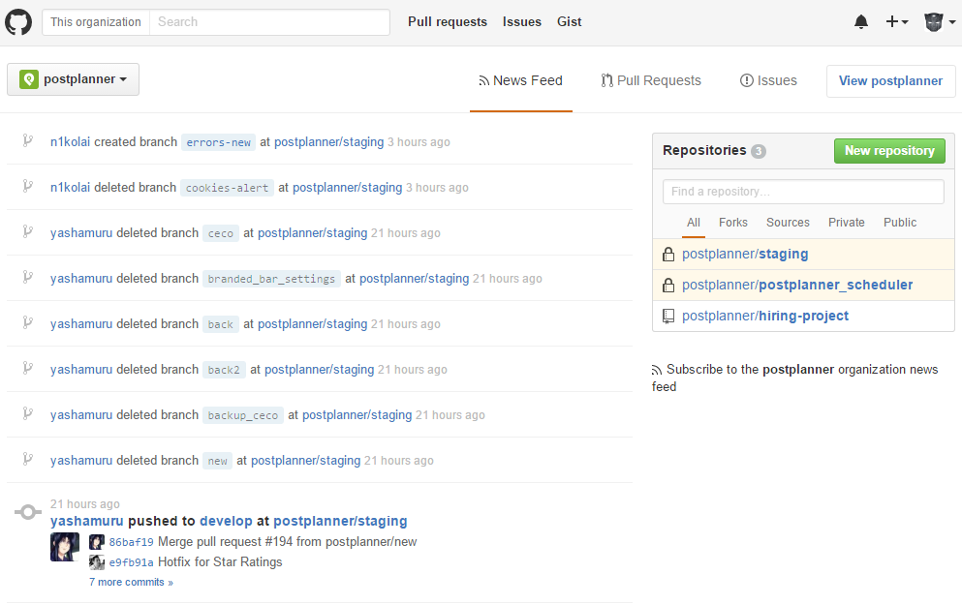
GitHub

Slide 19

Questions?

Slide 20
Resources
An Introduction to Version Control Using GitHub Desktop:
https://programminghistorian.org/en/lessons/getting-started-with-github-desktop
Github Guides
https://guides.github.com/
Git Branching
https://learngitbranching.js.org/
Gitflow Workflow
https://www.atlassian.com/git/tutorials/comparing-workflows/gitflow-workflow
Learn Git
https://www.atlassian.com/git/tutorials/learn-git-with-bitbucket-cloud

